Slide 1
Computing Paradigms
An Overview of Modern Computing Models

Slide 2
Centralized Computing
Definition: All processing is done on a single central server or mainframe.
Example: Traditional mainframe systems.
Pros: Simple management, centralized control.
Cons: Scalability and fault tolerance issues.

Slide 3
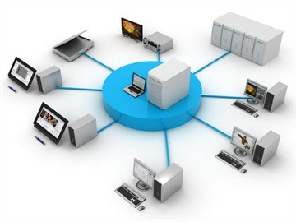

Slide 4
Distributed Computing
Definition: Computation is spread across multiple machines (nodes) connected via a network.
Example: Hadoop, Distributed databases.
Pros: Scalability, resource sharing.
Cons: Complexity in synchronization and fault tolerance.

Slide 5
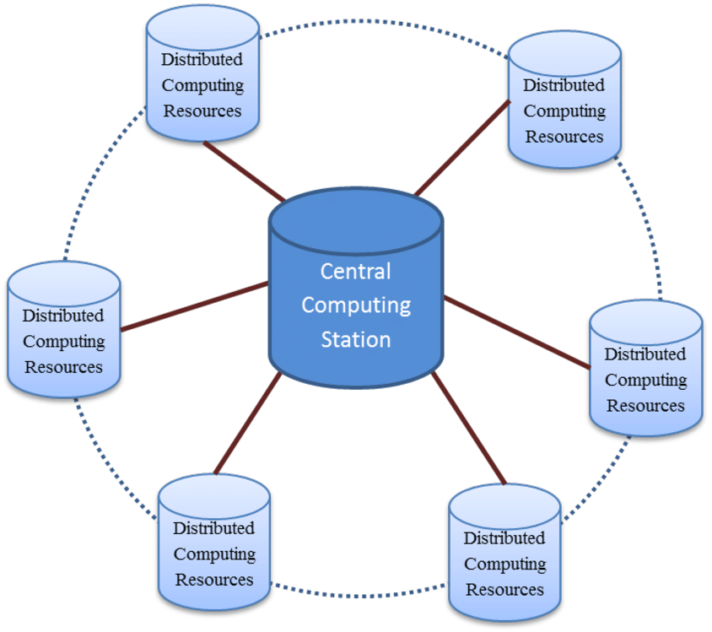
DISTIBUTED CLOUD COMPUTING

Slide 6
Parallel Computing
Definition: Multiple processors perform computations simultaneously on different parts of a problem.
Example: GPU computing, MPI.
Pros: High performance, faster execution.
Cons: Requires parallelization logic, may involve race conditions.

Slide 7
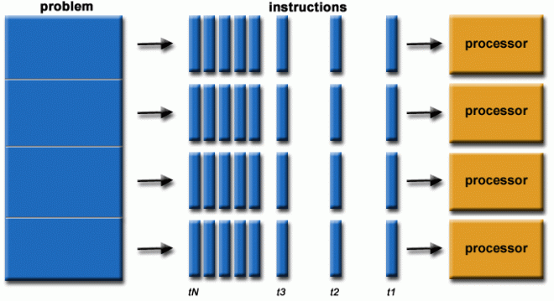
PARLLEL COMPUTING

Slide 8
Cluster Computing
Definition: A group of connected computers that work together as a single system.
Example: Beowulf clusters.
Pros: Cost-effective performance improvement.
Cons: Needs careful configuration and load balancing.

Slide 9
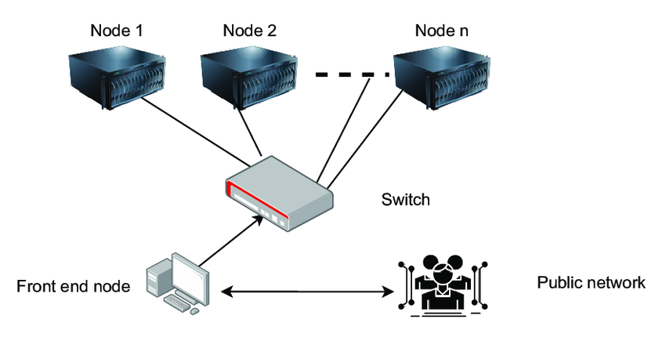
CLUSTER COMPUTING

Slide 10
Grid Computing
Definition: Uses geographically distributed resources to reach a common goal, often across organizations.
Example: SETI@home, Folding@home.
Pros: Resource sharing at a global scale.
Cons: Security and resource allocation challenges.

Slide 11
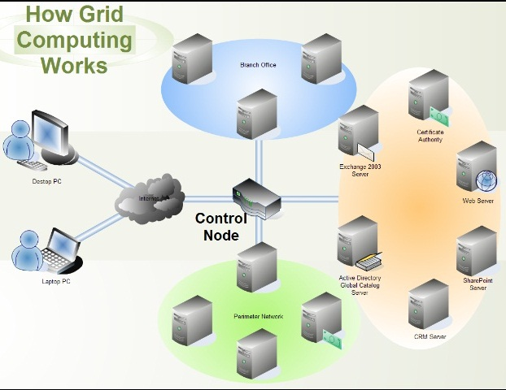
GRID COMPUTING

Slide 12
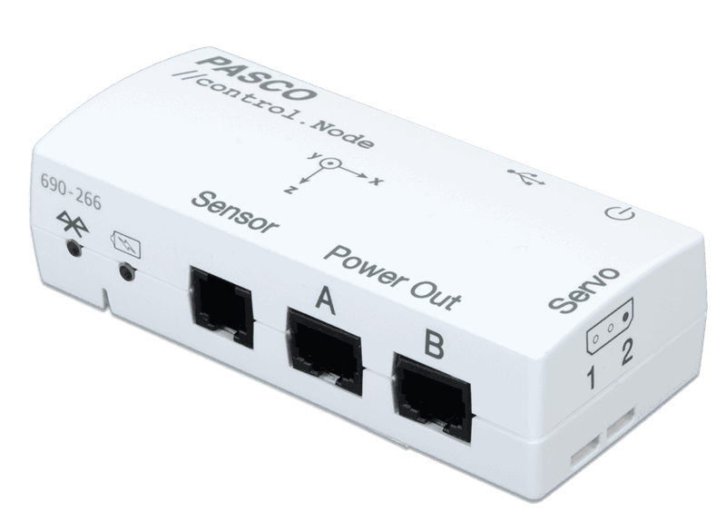
CONTROL NODE

Slide 13
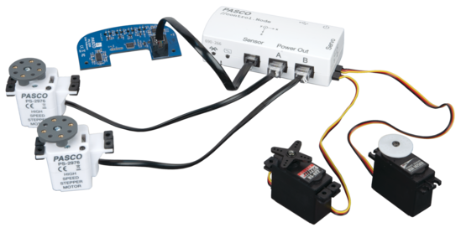
CONTROLLING THE COMPONENTS

Slide 14
Cloud Computing
Definition: Getting computing services like storage, servers, or software whenever needed through the internet.
Example: AWS, Azure, Google Cloud.
Service Models: IaaS, PaaS, SaaS
Pros: Scalability, flexibility, cost-effectiveness.
Cons: Internet dependency, data privacy.

Slide 15
Edge Computing
Definition: Data processing occurs near the source of data (e.g., IoT devices).
Example: Smart traffic lights, wearable devices.
Pros: Low latency, reduced bandwidth usage.
Cons: Limited local processing power.

Slide 16
Fog Computing
Definition: Extension of cloud computing to the edge with intermediary fog nodes.
Example: Industrial IoT systems.
Pros: Improved latency and context-awareness.
Cons: Management and security complexity.

Slide 17
Quantum Computing
Definition: Uses quantum bits (qubits) that can represent multiple states simultaneously.
Example: IBM Q, Google Sycamore.
Pros: Exponential speedup for specific problems.
Cons: Still experimental, requires specialized hardware.

Slide 18
Ubiquitous / Pervasive Computing
Definition: Computing integrated into everyday objects and activities.
Example: Smart homes, wearable tech.
Pros: Seamless user experiences.
Cons: Privacy and security concerns.

